Slide 1
Treatment of Psychological Disorders: Basic Features
Client & Therapist
Treatment is based on Theory
Inpatients
Establish a special relationship
Identifying causes of the clients problems.
Treated in hospitals or residential institutions
Outpatients
Voluntarily or involuntarily committed
Behaviors are severe enough to cause a threat to themselves or others
Range for a few days/weeks or years (in rare cases)
Receive psychotherapy and/or drugs while living in the community
Tend to have fewer, or less severe symptoms
Functions better in social/occupational situations

Slide 2
Basic Features Continued
Psychiatrists
Psychologists
Treatment Goals
Medical doctors
Those offering therapy have usually earned a doctoral degree in clinical or counseling psychology
Help individuals change their thinking, feelings, and behavior
Specialty in treating psych. Disorders
Authorized to prescribe drugs relief of psych. problems
Additional specialized training
Promote happiness & improve overall functioning

Slide 3
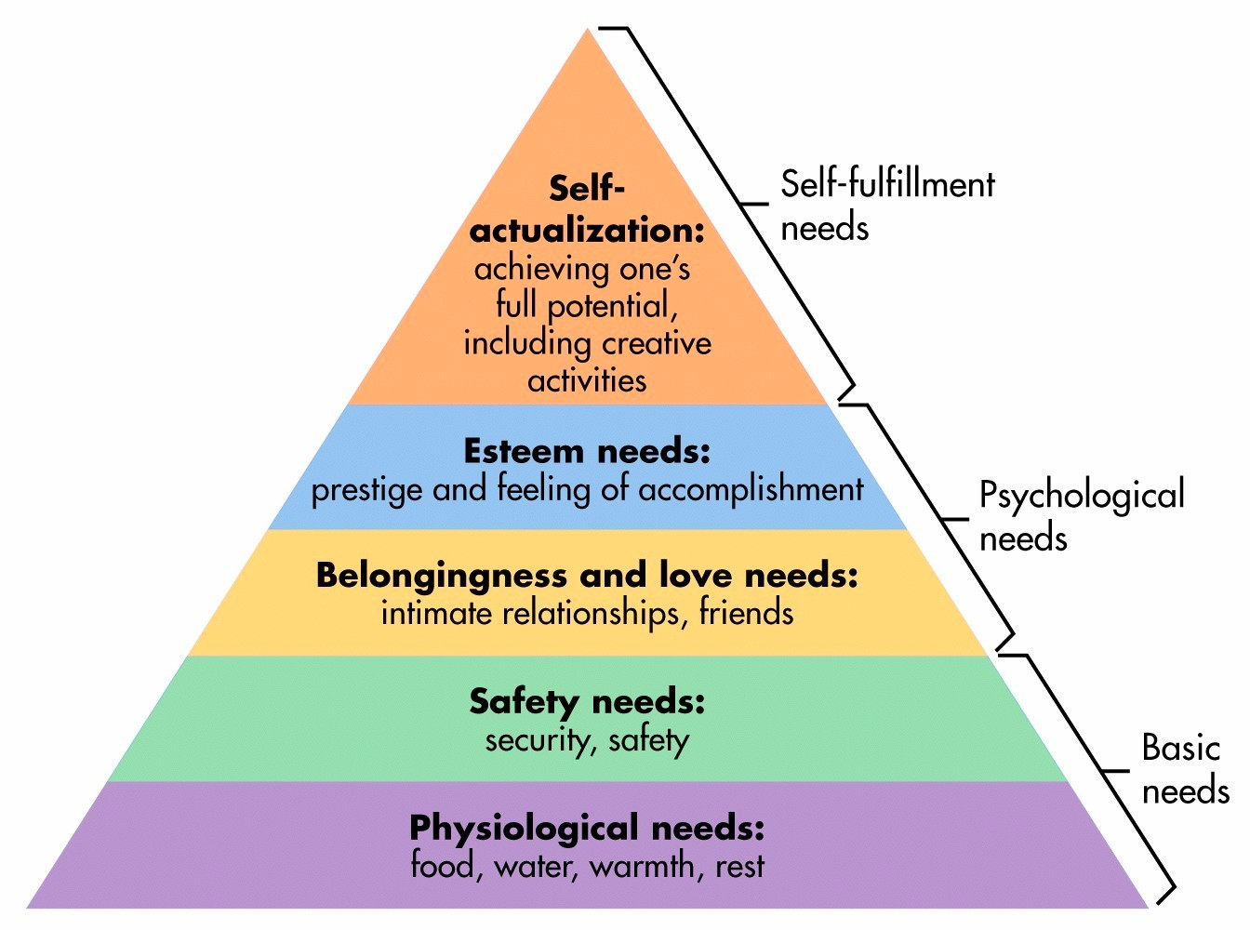
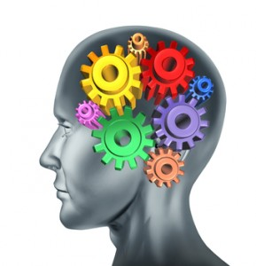
Therapy
“Therapy” is a generic term to mean treatment
like “pets” is a generic term to mean domesticated animals in the home
Insight Therapies - help patient better understand him/herself
Includes psychoanalytic, humanistic, and cognitive
Behavioral Therapy
Biomedical Therapy

Slide 4
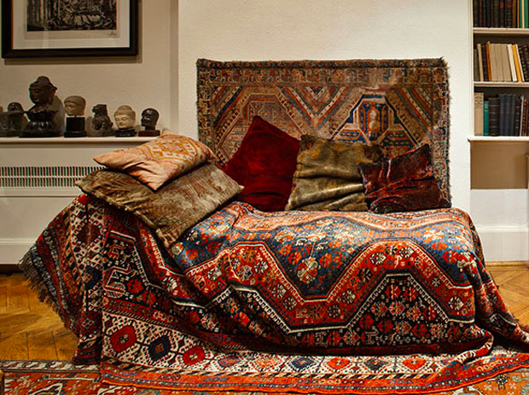
Psychoanalysis
Freud – importance of unconscious mind
unconscious conflict → anxiety which then manifests into abnormal behavior
intensive & long-term therapy
Free association & transference
Dream analysis
Psychoanalysis of NeoFreudians is shorter and brings together past and future of patient

Slide 5
(continued)
Ego analysis, interpersonal therapy, individual analysis, object relations
Object relations →
Significance of secure attachment – insecure attachment leads to abnormal behavior

Slide 6
Humanistic
Human or client-centered therapy
note, this is “client” not “patient-centered” therapy
Therapist and client are on equal footing
Therapy emphasizes necessity of free will and self-actualization
Group and Family therapies are typically Humanistic

Slide 7
Carl Rogers (Humanistic)
Clients direct the therapeutic process
Therapists display
Genuineness
Unconditional positive regard
Empathy

Slide 8
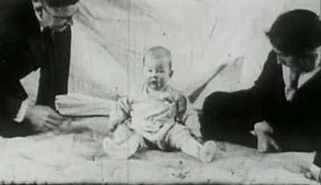
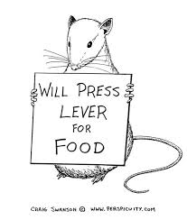
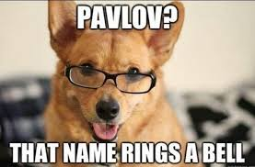
Behavior Therapy
Principles of learning (aka conditioning) to learn healthy behaviors
Think of…
Used often for phobias and anxiety disorders

Slide 9
Behavior Therapies
Goal – change unhealthy behaviors
Systematic Desensitization – create new associations for the original phobic stimulus
Aversion Therapy - create an unpleasant reaction to a stimulus
most commonly used with treating alcoholism
Extinction techniques – either by removing reinforcement or flooding
Token economies
Punishment

Slide 10
Cognitive Therapy
Goal – change irrational thoughts
Rational Emotive Behavior Therapy (REBT)
patients lack “self-talk”
therapist leads patient to confront each irrational thought
change in thought = change in emotion
Cognitive Therapy
cognitive schemas evolve our perception
automatic thoughts “anyone could have done that”
clients write-out situation, emotion, thought, response to find automatic patterns

Slide 11
Biomedical Therapy
Specific medical procedure and medication to alleviate symptoms
Alter neurochemical systems in brain (chemicals that make brain neurons function)

Slide 12
Neuroleptics
A.k.a. Antipsychotics
Successfully treats schizophrenia
reduces hallucinations, delusions, paranoia
act as dopamine blockers
May cause dyskinesia (facial tics)
see video

Slide 13
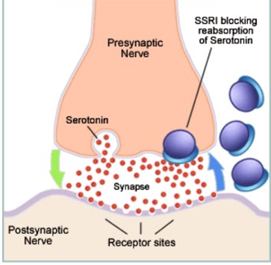
Antidepressants
Successfully used to treat depression
Increases serotonin and norepinephrine
MAOIs – used infrequently because of possible toxic reaction
TCAs – fewer side effects
SSRIs – best medication, also used for panic disorders

Slide 14
Lithium and Anticonvulsants
Used for bipolar disorder
Help to even out the highs and lows of bipolar disorder
Both used – lithium takes time to respond, other anticonvulsants more immediate

Slide 15
Anxiolytics
aka antianxiety (kinds of looks like anxiety)
“tranquilizers” to treat anxiety disorders
benzodiazepines (Valium and Librium)
High risk of developing addiction

Slide 16
Electroconvulsive Therapy (still biomedical)
a.k.a. ECT
Used for severe depression
electric current passed through brain → leads to convulsions to “reset” brain waves
leads to temporary memory loss (which part of the brain…?)

