Slide 1
Sensation and Perception

Slide 2
Sensation
Definition: signals and stimuli we pick up through our sense organs
  Energy -- sound, light, heat, pressure,
  Air and chemical molecules
Sensation differs from person to person

Slide 3
Sensation
Primary systems: vision, touch & hearing
Secondary: smell, taste, kinesthetic (movement), vestibular (sense of balance)

Slide 4
Sensory receptors
Detect changes in energy
  Stimuli must break the “threshold”
Constant level of stimulation = adaptation & overstimulation
  (are you wearing socks?)

Slide 5

Perception
Definition: organizing the information we have received from the senses

Slide 6
Perception
Can perceive what is not there
  Your mind fills in the blank
  i.e. dreams
Expectations = perception
Subliminal messages

Slide 7
Perception Patterns
Proximity= we group objects that are close together
      *&* $ * & @ # $
Similarity= we group objects that resemble each other
      &&&&&& $$$$$$$$
      OOOOOO
Closure= our brains fill in gap

Slide 8
Gestalt
Bottom Up Processing
Top Down Processing
Relies on specific, detailed info elements from sensory receptors that are integrated and assembled into a whole
Guided by knowledge, expectations, and other psychological factors.
  Schema: categories/groupings
    can bias our perception leading to a perceptual set

Slide 9
XXXXXXXXXXXX
X
X
X
X
XXXXXXXXX
X
X
X
X
XXXXXXXXXXXX

Slide 10
Arocdnicg to rsceearch at Cmabrigde
Uinervtisy, it deosn’t mttaer in waht oredr
the ltteers in a wrod are, the olny
iprmoatnt tihng is taht the frist and lsat
ltteer are in the rghit pcale. The rset can
be a toatl mses and you can sitll raed it
wouthit pobelrm. Tihs is buseace the
huamn mnid deos not raed ervey lteter by
istlef, but the wrod as a wlohe.

Slide 11
Biases in perception
Activity 5.13
Activity 5.18

Slide 12
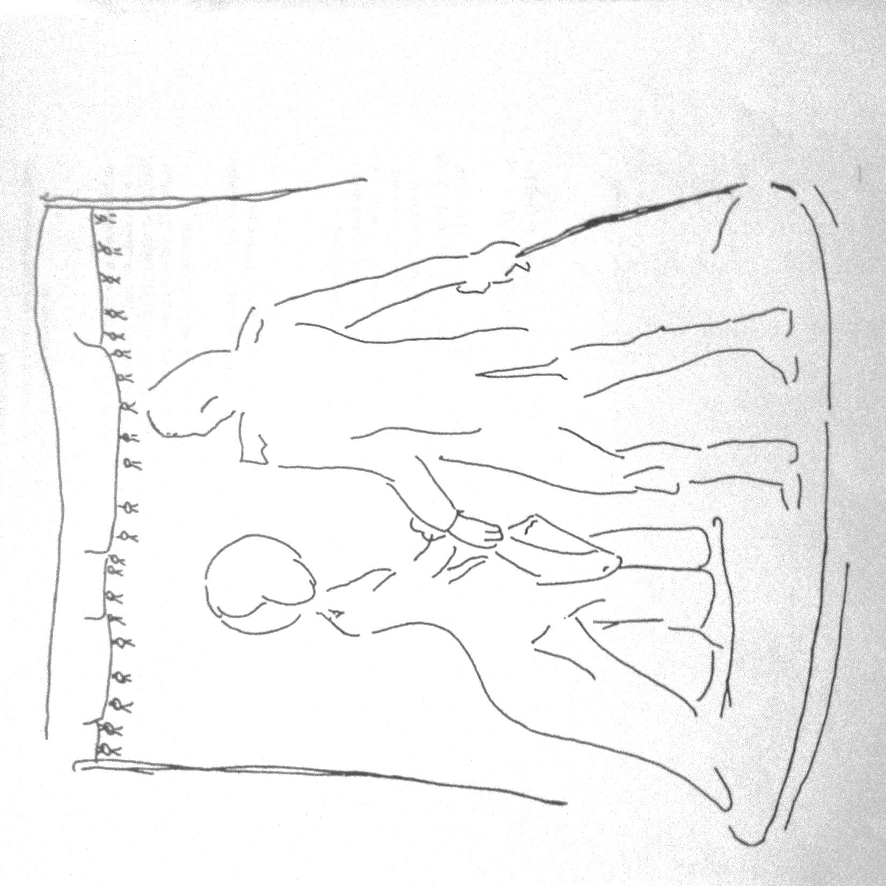

Slide 13
Object 1
Object 2

Slide 14
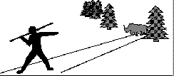
Culture and Perception
A study conducted in Kenya showed that the villagers could not interpret it in that way. As far as they were concerned the picture showed either a very big man or a very small rhino.

Slide 15
Subliminal Perceptions
Weak stimuli, unaware of the sensations being stimulated
  Backward messages in songs
  Flashing images in commercials
  Sound clips just below our typical threshold
Subliminal messages in movie theaters, audience was not aware of seeing them.

Slide 16
Attributes that impact success of subliminal stimulation.
  Strength
  Speed
  Nature of the stimulation immediately after
  General train of thought of the viewer

Slide 17
Attention
Can not/do not react to all stimuli
Perception = what we pay attention to
We pay attention to:
  Intensity
  Size
  Contrast
  Movement
  Changes
  Novelty
  Repetition.

Slide 18
Attention of Individuals
Present condition
Trends
  Needs
  Attitudes
  Expectations
  Motives
  past experiences
Once attention is focus on stimulus, stimulus will retain our attention

Slide 19
View Elevator clip
https://www.youtube.com/watch?v=IGQmdoK_ZfY

Slide 20
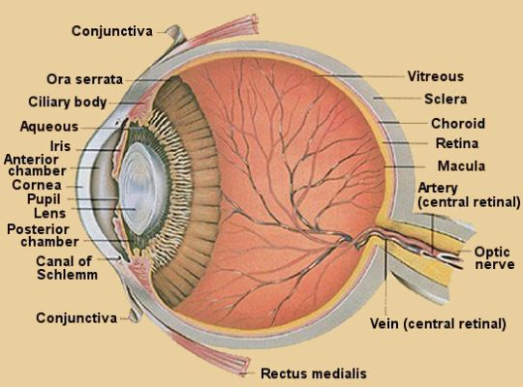
Perceiving Distance and Depth
Achieved with movement of
eye muscles.
Signals to tell you depth and
distance:
      Accommodation
      Convergence
      Binocular disparity

Slide 21
Cues Based on Physiology
Accommodation – muscles surrounding the lens either tighten (to focus on close objects) or relax (to focus on distant objects)
Convergence – each eye rotates inward to see closer objects
Binocular Disparity – the difference between the two retinal images of an object provides distance cues

Slide 22
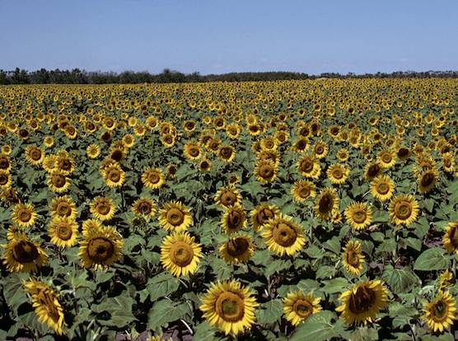
Texture gradient= the amount of detail perceived in an object.

Slide 23
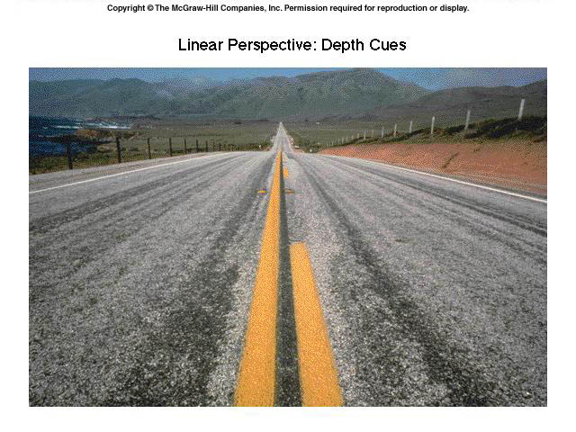
Linear perspective= the farther away objects are, the closer together they appear

Slide 24
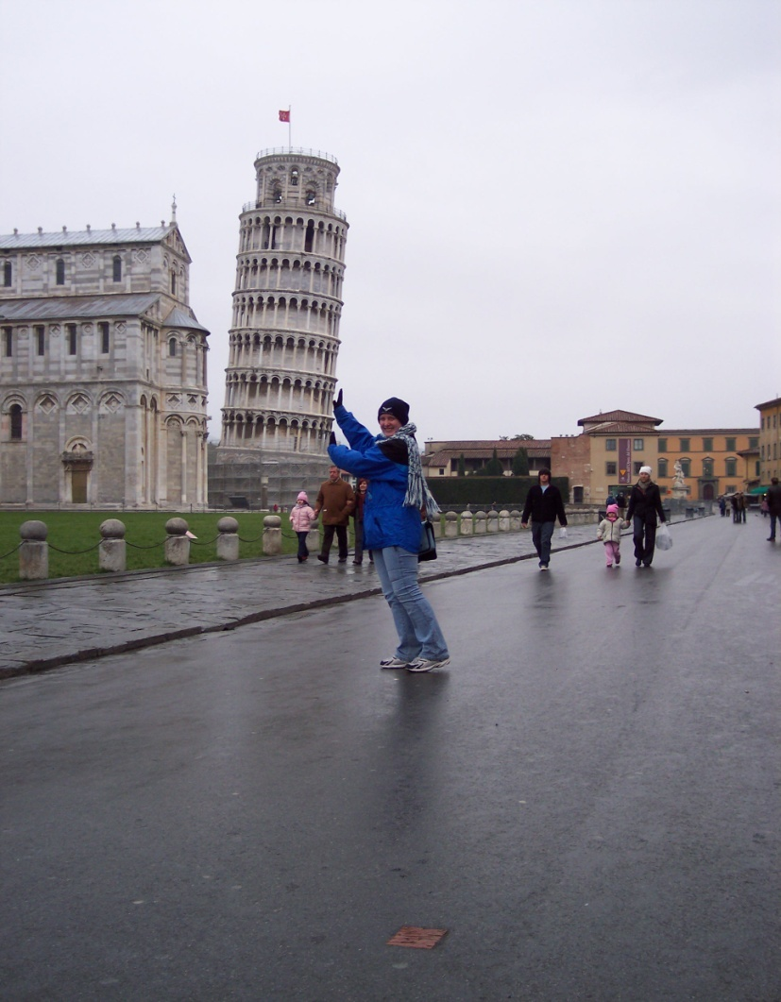
Size – using standards on familiar objects to determine distance

Slide 25
View Ball and Shadow clip
http://www.weirdoptics.com/ball-shadow-illusion/

Slide 26
Optical illusions
Mistakes in perception
Practical purposes= clothing, TV/movies, Ads, etc.

Slide 27
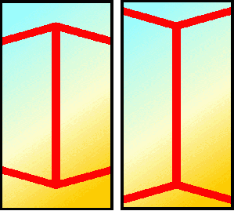
Is the middle line longer in the image on the left or on the right?

Slide 28
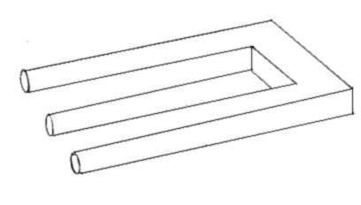
How many legs does this shape have?

Slide 29
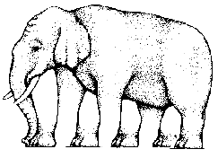
How many legs does this elephant have?

Slide 30
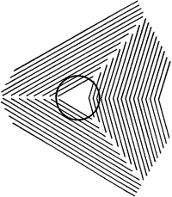
Need a volunteer to draw the shape the dark line makes on the board

Slide 31

Which image has a larger center dot, image on the left or image on the right?

Slide 32
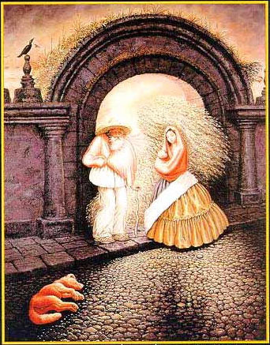

Slide 33
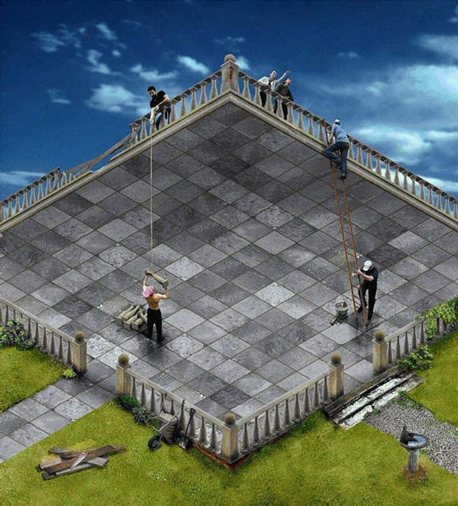

Slide 34
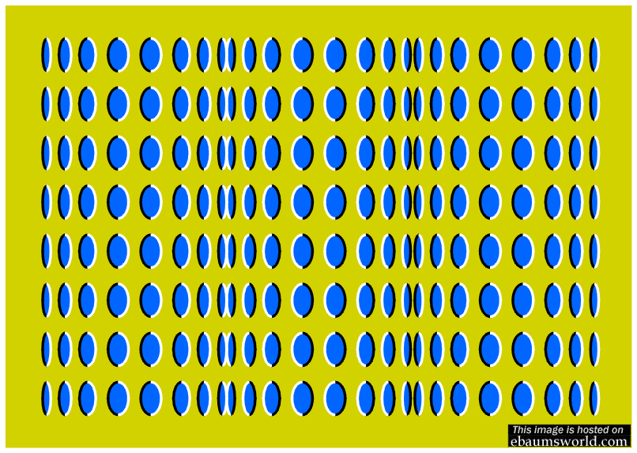

Slide 35
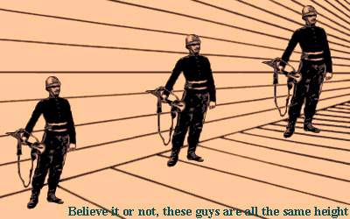

Slide 36
Homework for the weekend!!
☺
Pay attention to your dreams over the
weekend, we’ll be using them for some
research next week.

